Slide 1
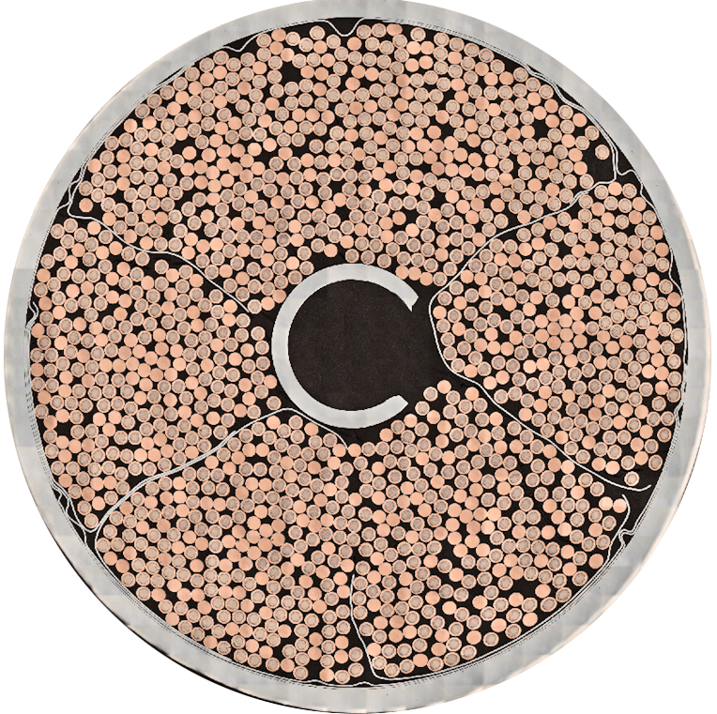
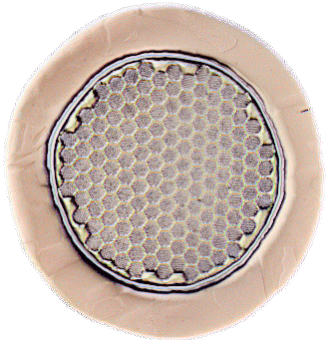

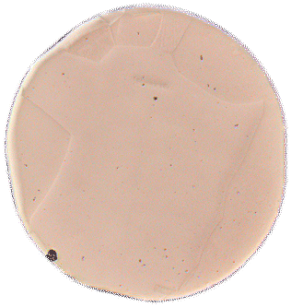

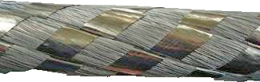



ITER CICC: Components
Stage 1 (inner triplet):
2x sc +1x Cu
Both sc and Cu strands used.
5 cable stages.
Stage 2: x3
Stage 3: x5
Stage 4 (petal): x5 around (3x4 Cu) core + stainless steel wrap
Stage 5: x6 around central cooling spiral + stainless steel wrap
Stainless steel wrap
Austenitic stainless steel
conduit tube
ITER TF Cable
Central Cooling Spiral
Peter J. Lee & Carlos Sanabria

Slide 2


Acknowledgements
  Work funded by ITER Organization with additional funding from the State of Florida and US DOE Office of Fusion Energy Science Grant DE‑FG02‑06ER54881.
  SULTAN-tested cable was provided by courtesy of Pierluigi Bruzzone (Plasma Physics Research Center) with agreement from Fusion for Energy.
  Metallographic assistance from Bill Starch, Timothy Blum and Jen Gavin (FSU).

