Slide 1
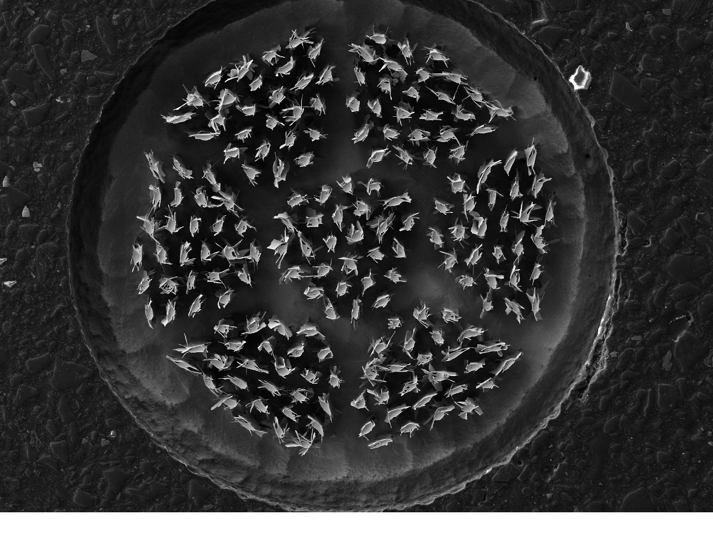
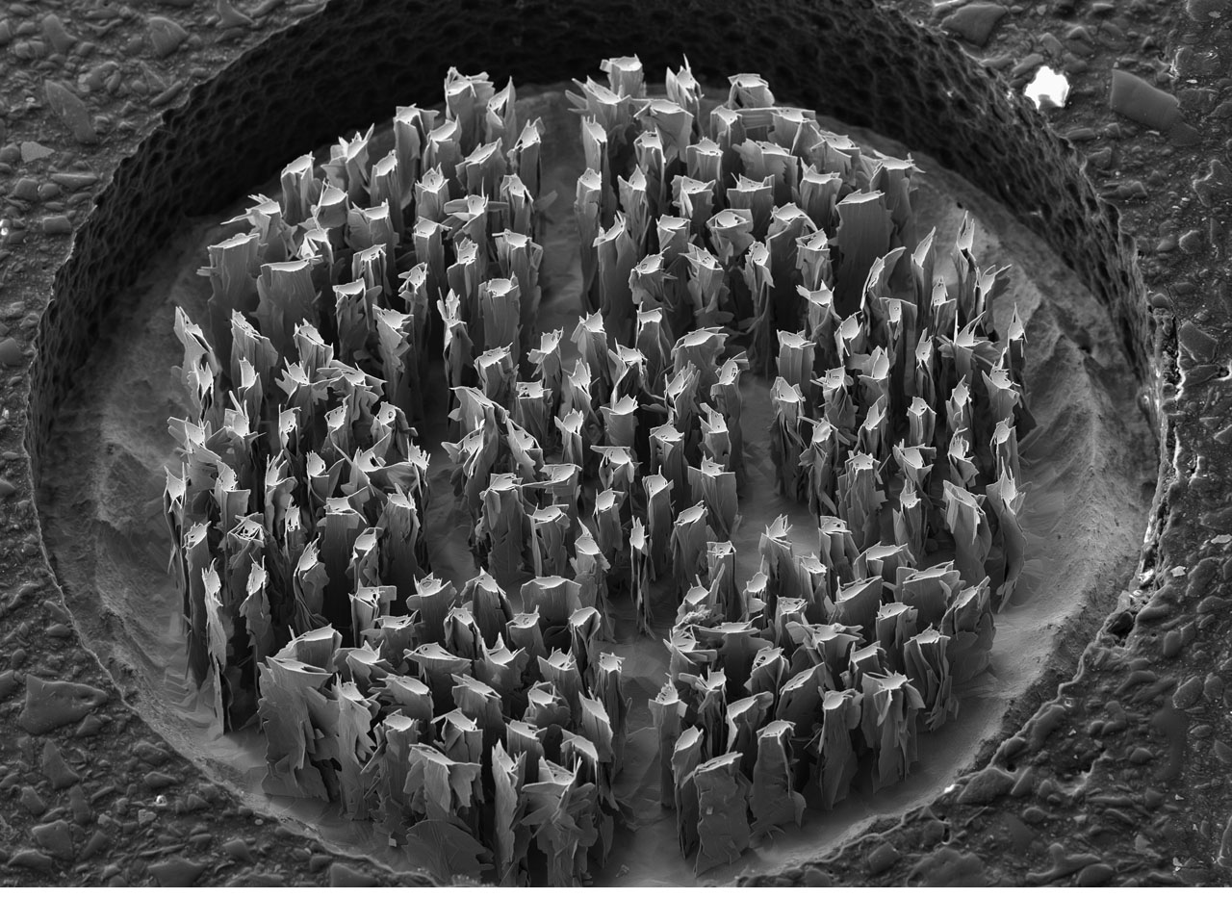
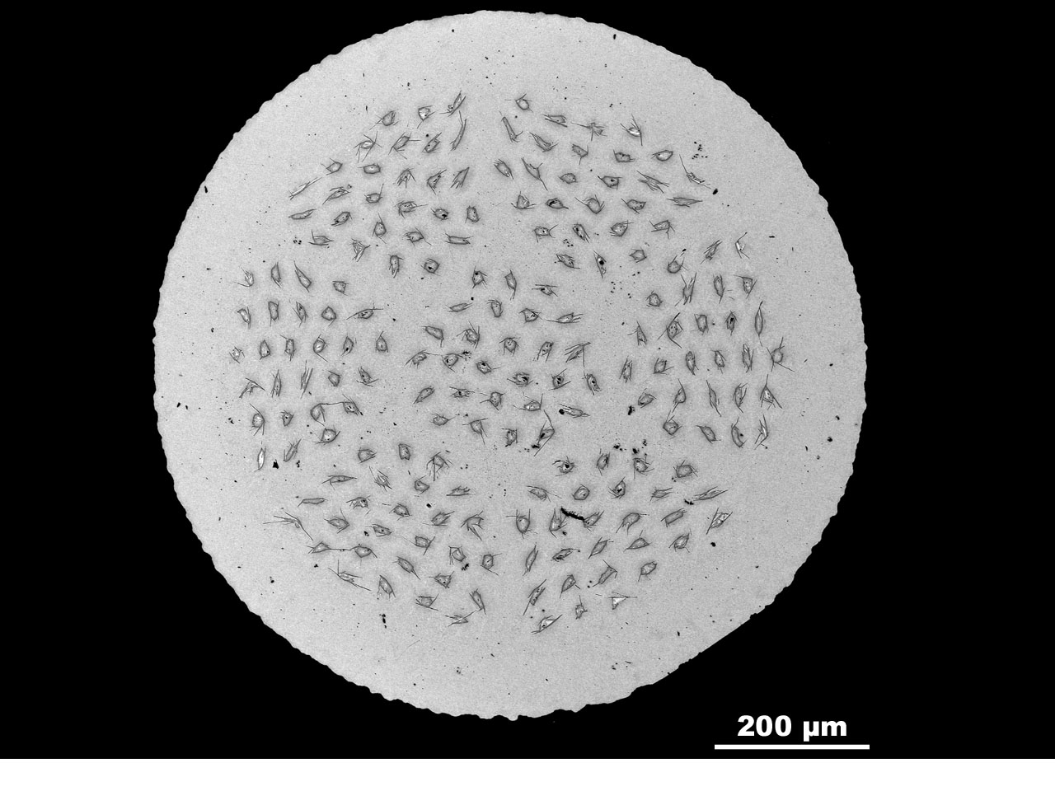
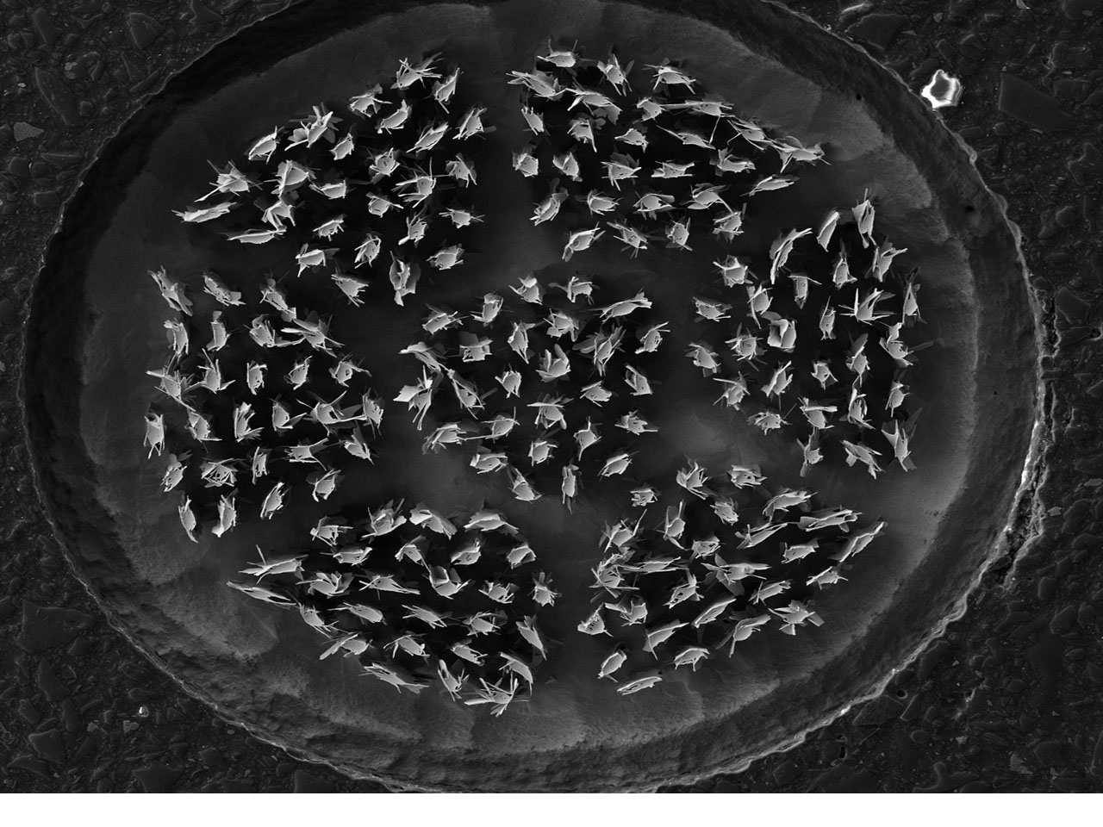

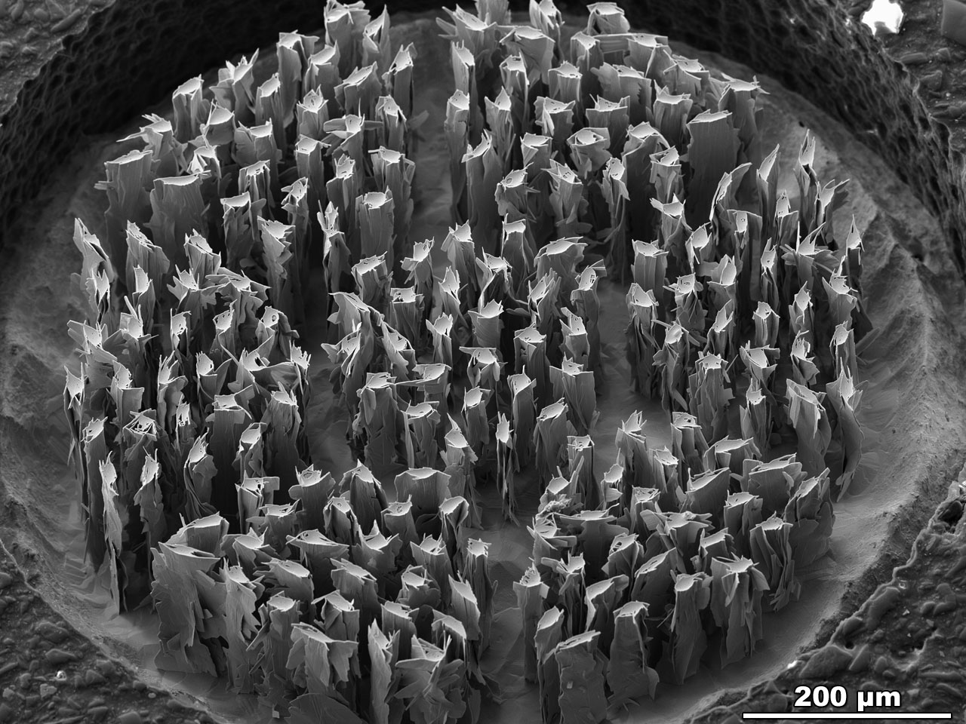
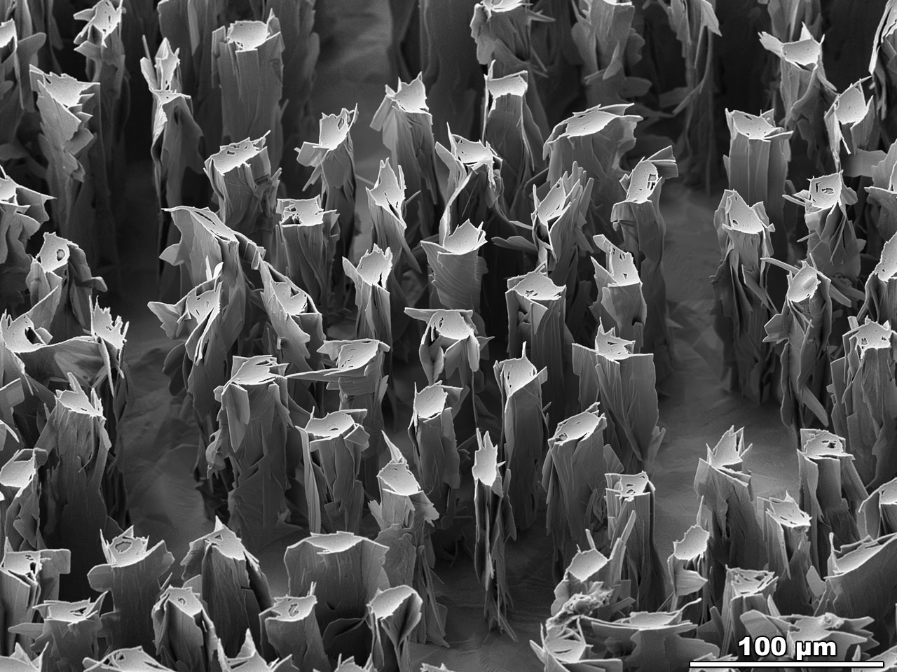
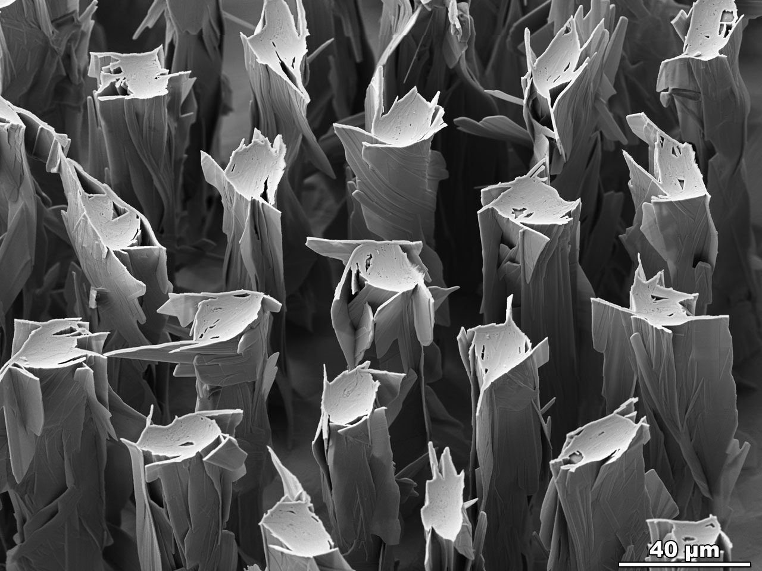
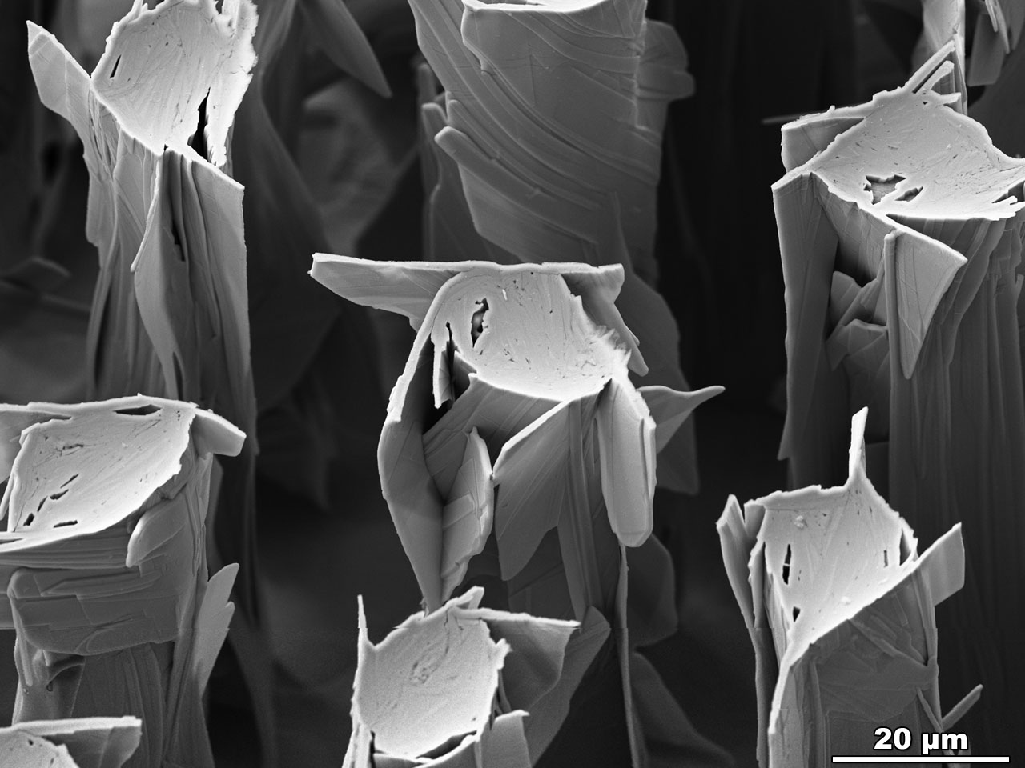
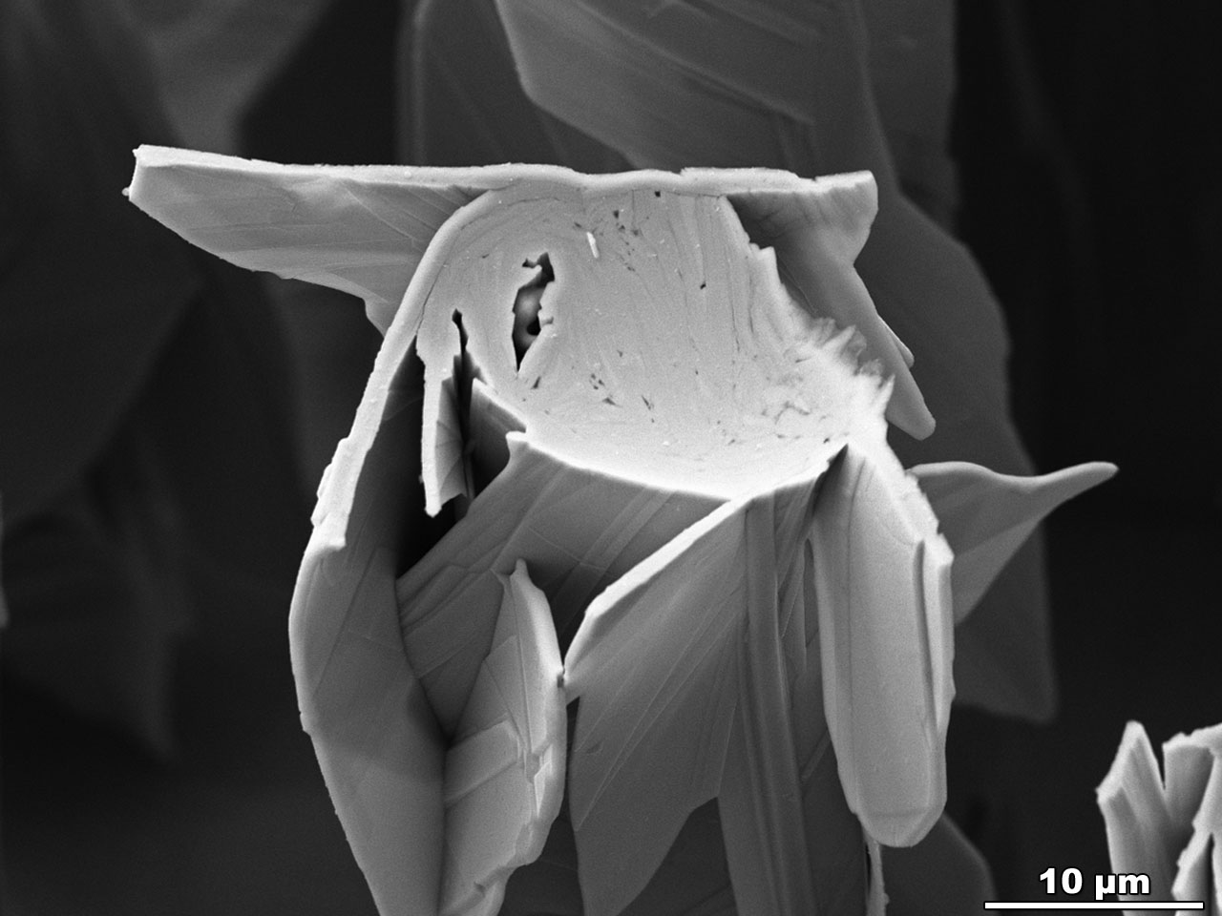

Transverse cross- section of a Bi-2212 round wire with 7 bundles of 27 filaments manufactured by OST. This wire was heat treated at 100 atm over-pressure to densify the filaments. The silver matrix was etched down to reveal the sub-surface filament structure.
Polished transverse cross- section of a Bi-2212 round wire with 7 bundles of 27 filaments manufactured by OST. This wire was heat treated at 100 atm over-pressure to densify the filaments.
FESEM-BSE Image by Jianyi Jiang, ASC, NHMFL
FESEM-SE2 Images (etched wires) by Maxime R. Matras, ASC, NHMFL

