Slide 1
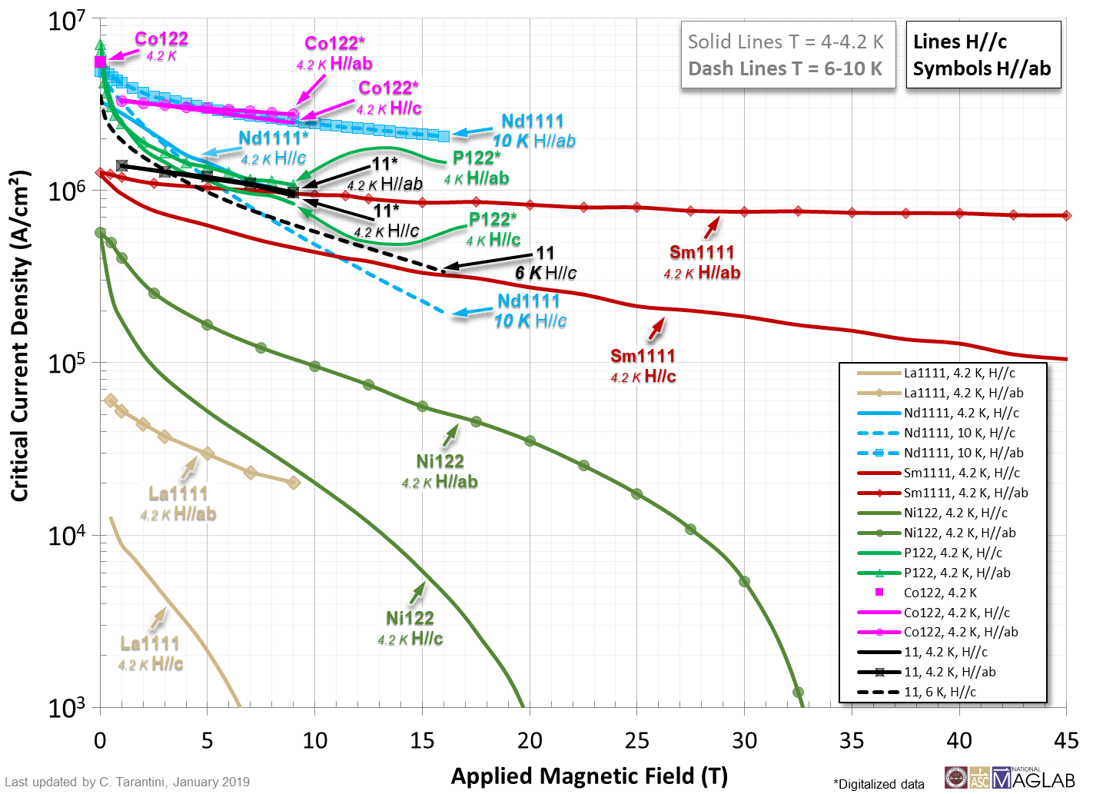

Slide 2
References
La1111, 4.2 K, H//c and H//ab: M. Kidszun et al. Critical Current Scaling and Anisotropy in Oxypnictide Superconductors, Phys. Rev. Lett. 106, 137001 (2011). https://doi.org/10.1103/PhysRevLett.106.137001
Nd1111, 4.2 K, H//c: M. Chihara et al. Direct growth of superconducting NdFeAs(O,F) thin films by MBE, Phycisa C 518, 69-72 (2015). https://doi.org/10.1016/j.physc.2015.03.022
Nd1111, 10 K, H//c and H//ab: C. Tarantini et al. Effect of α-particle irradiation on a NdFeAs(O,F) thin film, Supercod. Sci. Technol. 31, 034002 (2018). https://doi.org/10.1088/1361-6668/aaa821
Sm1111, 4.2 K, H//c and H//ab: K. Iida et al. Oxypnictide SmFeAs(O,F) superconductor: a candidate for high–field magnet applications, Sci. Rep. 3, 2139 (2013). https://doi.org/10.1038/srep02139
Ni122, 4.2 K, H//c and H//ab: S. Richter et al. Superconducting properties of Ba(Fe_{1–x}Ni_{x})₂As₂ thin films in high magnetic fields, Appl. Phys. Lett. 110, 022601 (2017). http://dx.doi.org/10.1063/1.4973522
P122, 4.2 K, H//c and H//ab: H. Sato et al. High critical-current density with less anisotropy in BaFe₂(As,P)₂ epitaxial thin films: Effect of intentionally grown c-axis vortex-pinning centers, Appl. Phys. Lett. 104, 182603 (2014). http://dx.doi.org/10.1063/1.4875956
Co122, 4.2 K: C. Tarantini et al. Development of very high J_{c} in Ba(Fe_{1-x}Co_{x})₂As₂ thin films grown on CaF₂, Sci. Rep. 4, 7305 (2014). https://doi.org/10.1038/srep07305
Co122, 4.2 K, H//c and H//ab: P. Yuan et al. Vortex pinning properties in Co-doped BaFe₂As₂ thin films with a high critical current density over 2 MA cm⁻² at 9 T, Supercond. Sci. Technol. 30, 025001 (2017). http://dx.doi.org/10.1088/0953-2048/30/2/025001
11, 4.2 K, H//c and H//ab: P. Yuan et al. Angular-dependent vortex pinning mechanism and magneto-optical characterizations of FeSe_{0.5}Te_{0.5} thin films grown on CaF₂ substrates, Supercond. Sci. Technol. 29, 035013 (2016). http://dx.doi.org/10.1088/0953-2048/29/3/035013
11, 6 K, H//c: S. Seo et al. Artificially Engineered Nanostrain in Iron Chalcogenide Superconductor Thin Film for Enhancing Supercurrent, arXiv: 1812.02380. https://arxiv.org/abs/1812.02380

