Slide 1
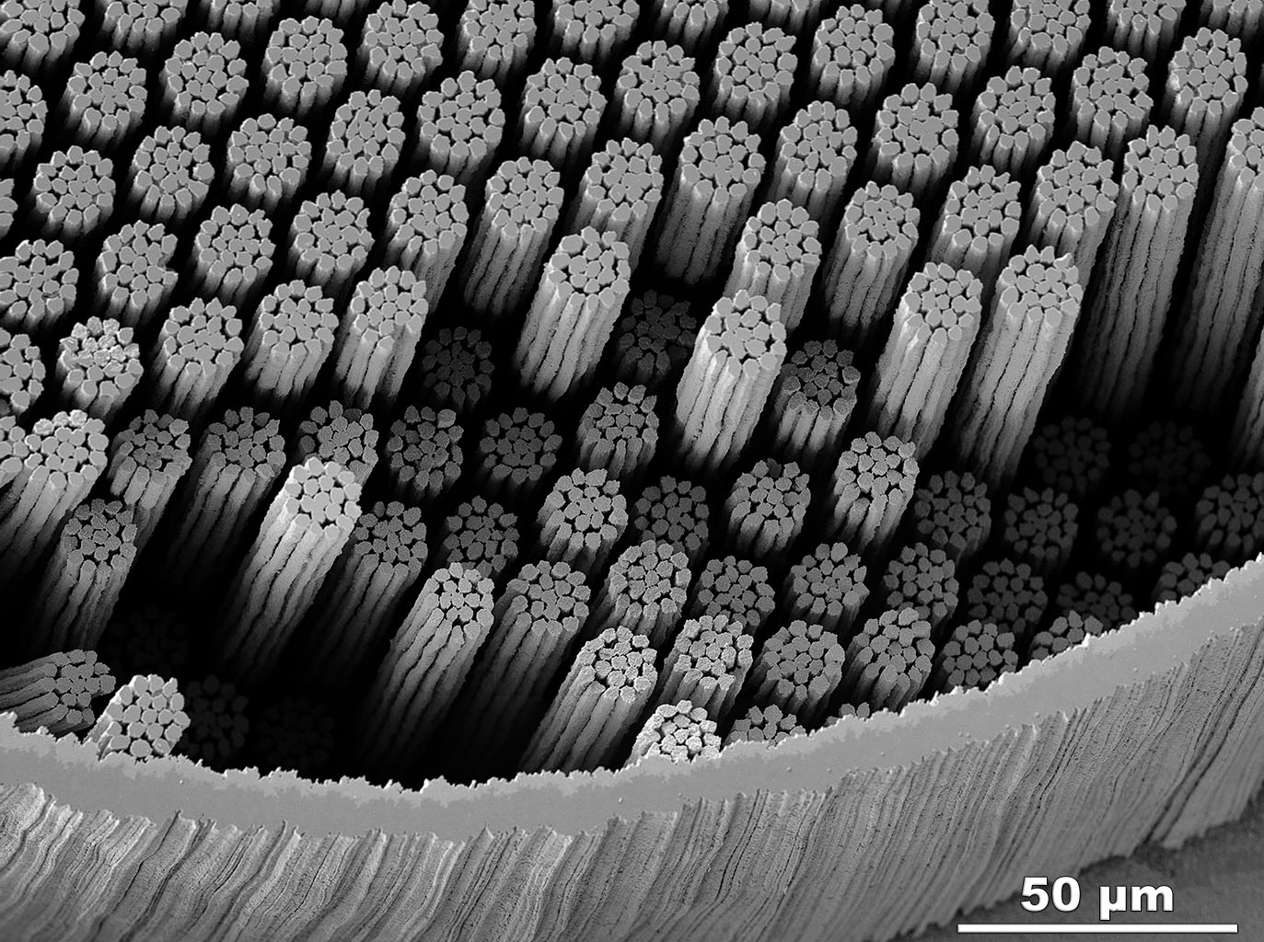
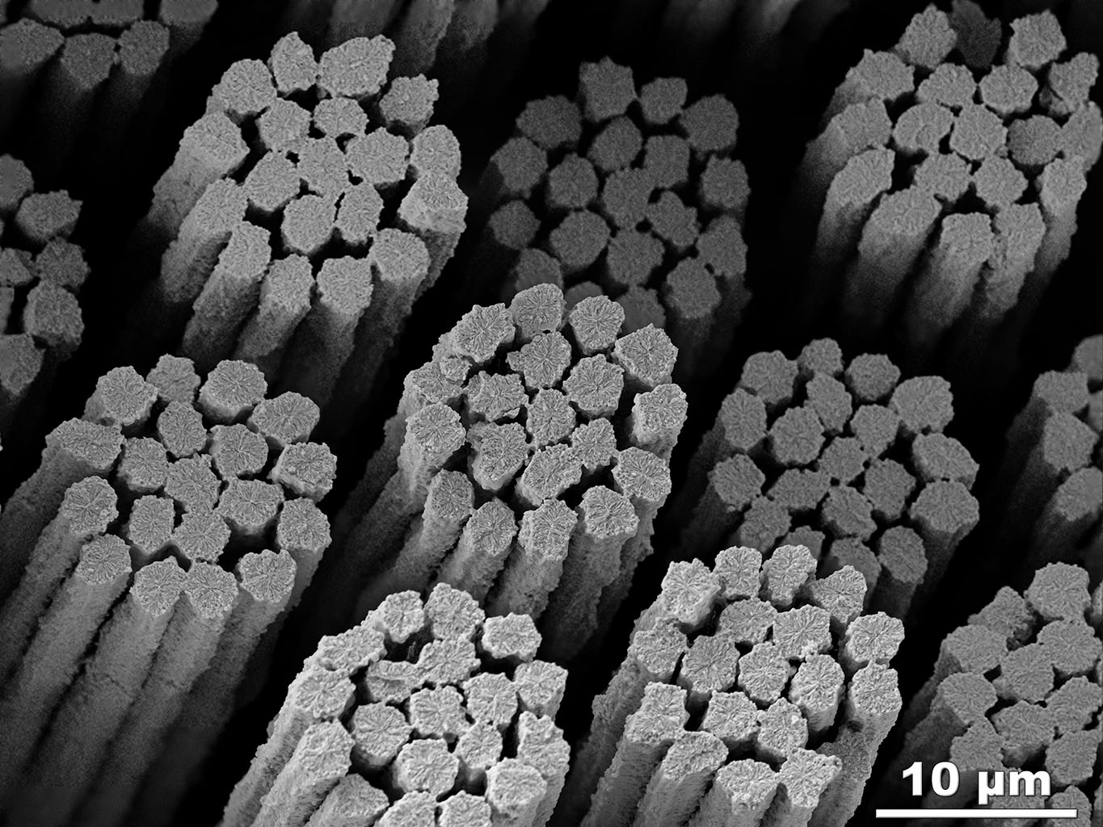
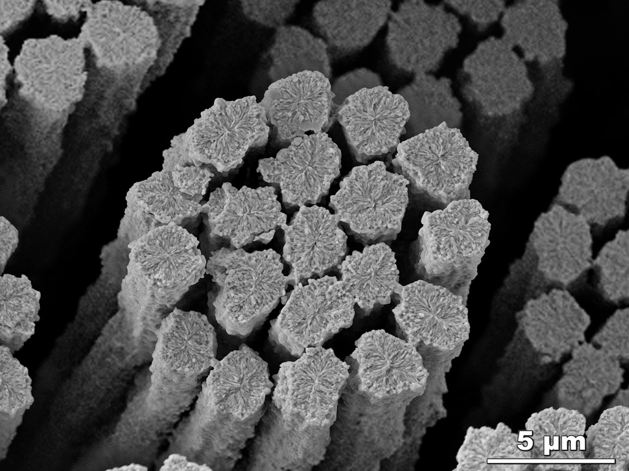
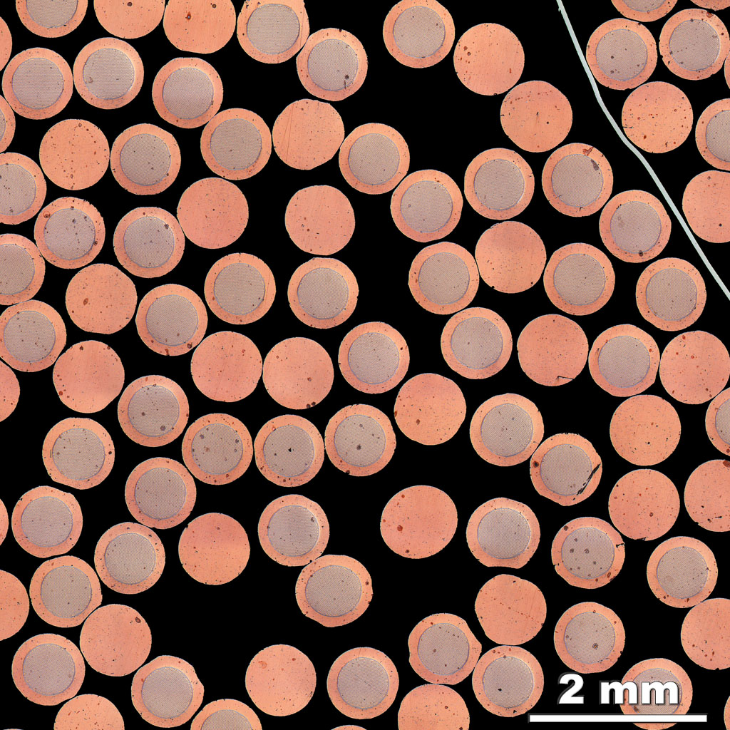
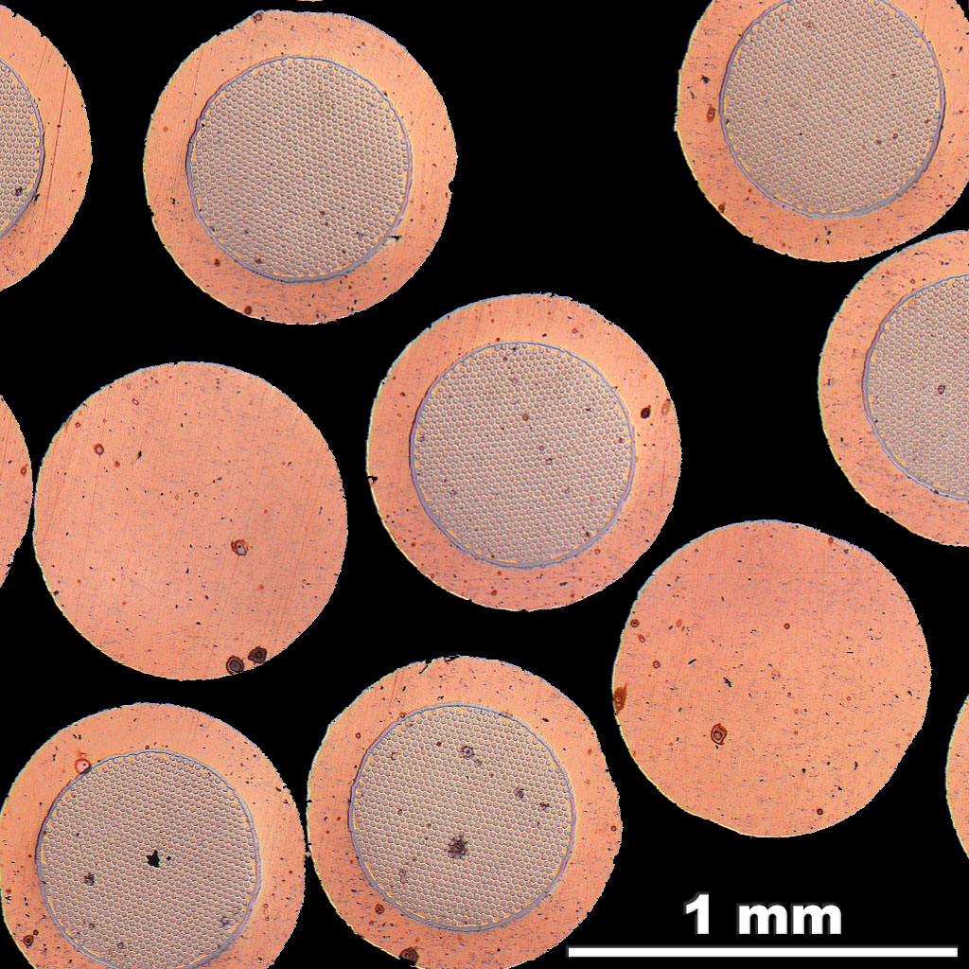
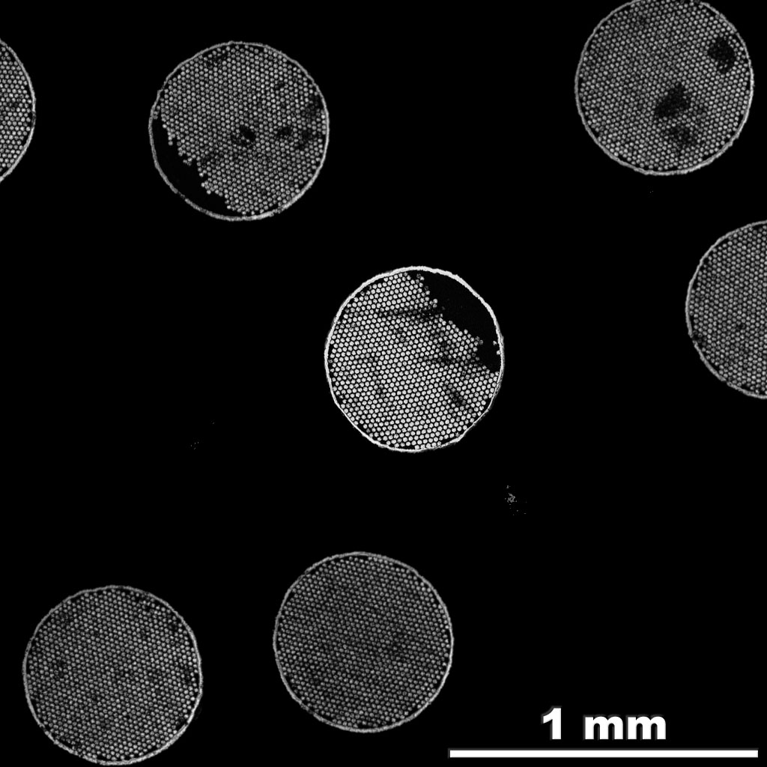
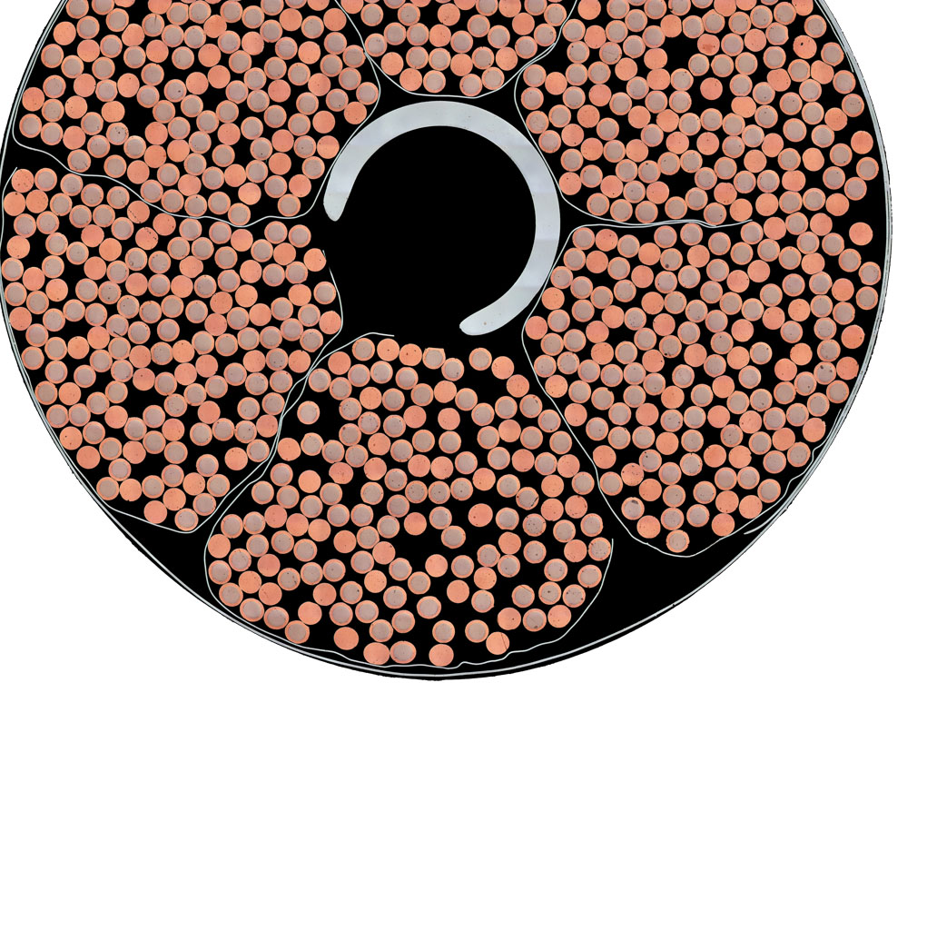
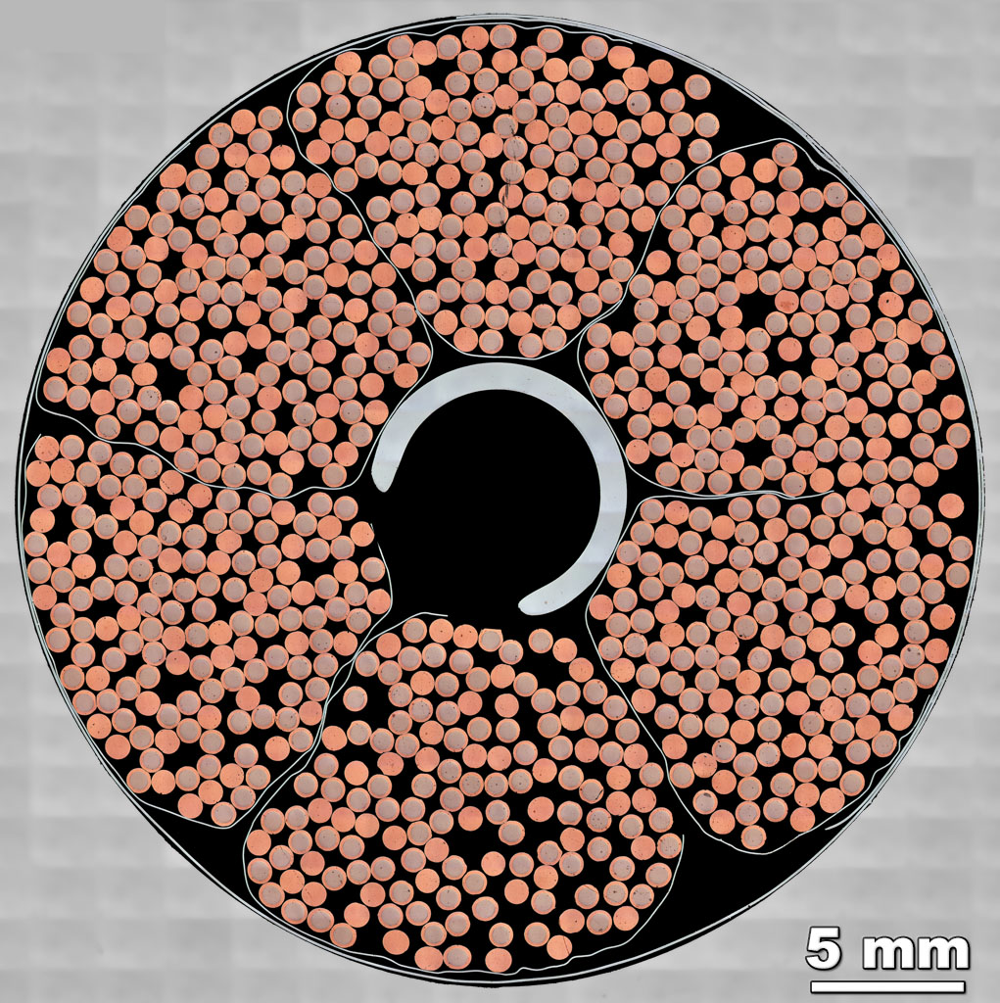
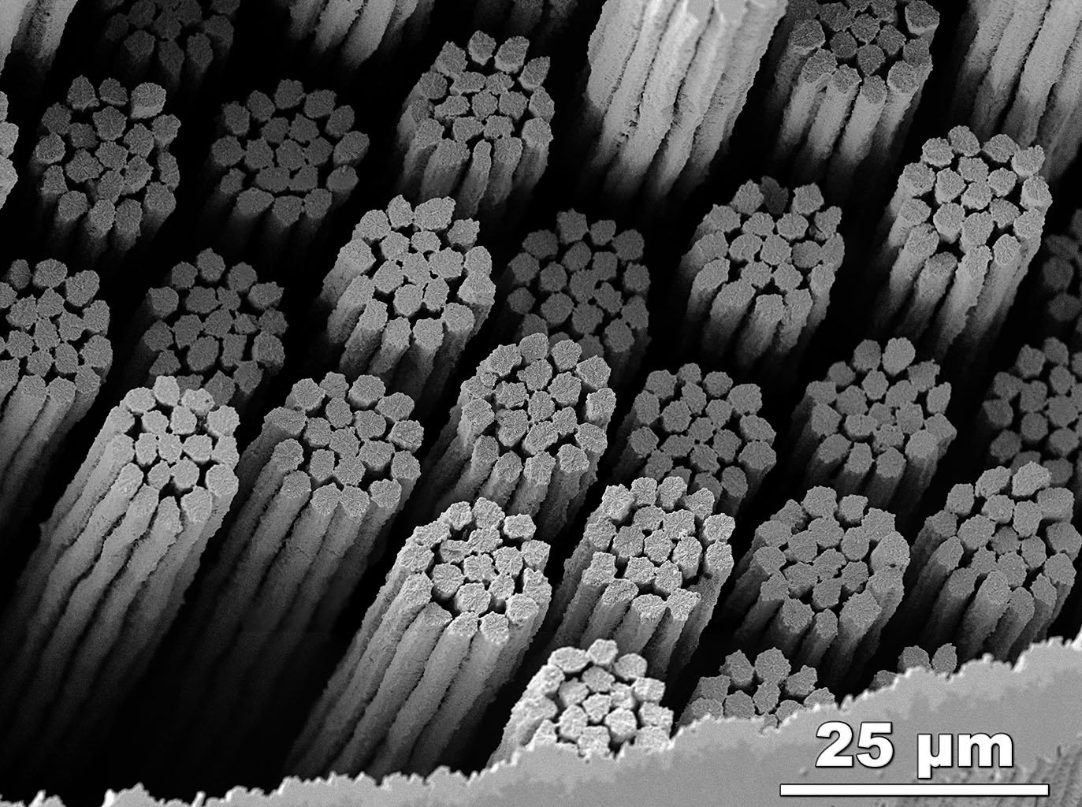



CSJA2
HFZ
The strands move in the direction of the Lorentz Force
The Nb₃Sn fractures at the grain boundaries and thus we see the grain structure across the filaments.
Click for:
Extended Zoom into area with broken filaments
Etching the Cu away allows broken filaments to fall out.
Filaments
fractured by strand bending
Opening up void space where strands can move more easily.
Lorentz Force
Peter J. Lee &
Carlos Sanabria
FESEM:
SE

Slide 2




Acknowledgements
  Work funded by ITER Organization with additional funding from the State of Florida and US DOE Office of Fusion Energy Science Grant DE‑FG02‑06ER54881 and US-ITER contract 6400011187.
  SULTAN-tested cable was provided by courtesy of Pierluigi Bruzzone (Plasma Physics Research Center) with agreement from Fusion for Energy.
  CSJA2 cable was also provided by arrangement with the Japan Atomic Energy Agency (JAEA), Superconductor Technology Group, Division of Fusion Energy Technology.
  Metallographic assistance from Bill Starch, Timothy Blum and Jen Gavin (FSU).

